Slide 1
Internet Transport Protocol - UDP

Slide 2
UDP
User Datagram Protocol
Connection less
Unreliable
No flow control
No error control
No congestion control

Slide 3
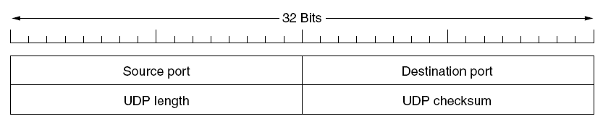
UDP header fields
Source Port
Destination Port
UDP Length
Length of the datagram (header size + payload size)
UDP Checksum

Slide 4
Remote Procedure Call - RPC

Slide 5
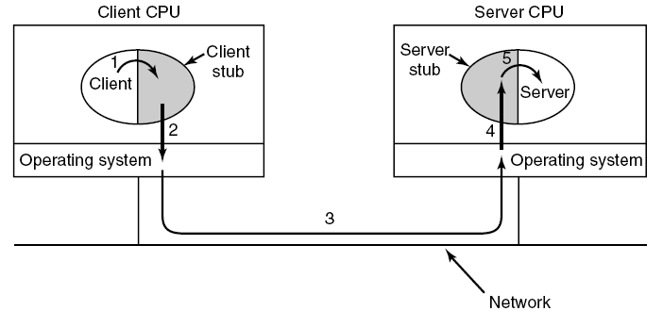
Steps in making a remote procedure call
The idea behind RPC is to make a remote procedure call look as much as possible
like a local one

Slide 6
RPC
Client program must be bound with a small library procedure, called the client stub. It represents the server procedure in the client’s address space
Server is bound with a procedure called the server stub
These procedures hide the fact that the procedure call from the client to the server is not local

Slide 7
Steps in RPC
STEP 1 – client calling the client stub. Parameters pushed onto the stack in the normal way
STEP 2 - client stub packing the parameters (marshaling) into a message and making a system call to send the message
STEP 3 - operating system sending the message from the client machine to the server machine
STEP 4 – operating system passing the incoming packet to the server stub
STEP 5 – server stub calling the server procedure with the unmarshaled parameters
The reply traces the same path in the other direction

Slide 8
Real Time Transport Protocol

Slide 9
Application Area
Real time multimedia applications –
Internet radio
Internet telephony
Music –on-demand
Video –on-demand
Videoconferencing

Slide 10
Where does RTP belong ?
RTP is a transport protocol implemented in Application Layer

Slide 11
Basic Function of RTP
Multiplex several real time data streams onto single stream of UDP data units

Slide 12
RTP
Does not perform/have the following –
Flow control
Error control
Mechanisms to request retransmissions
Acknowledgements

Slide 13
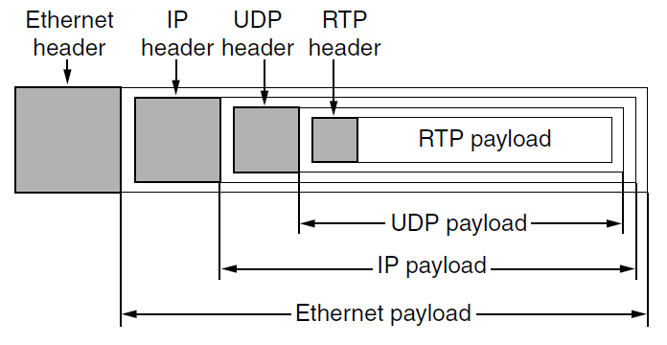
RTP Header

Slide 14
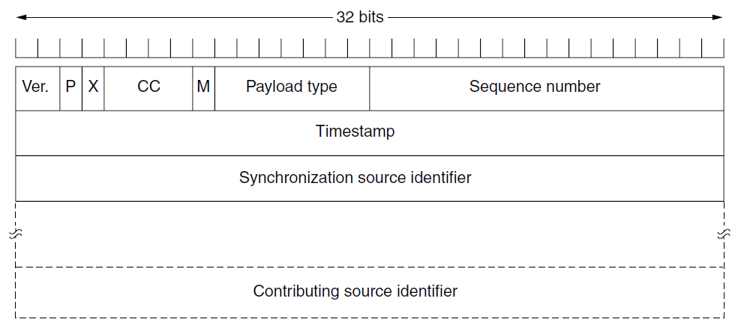
Fields of RTP Header

